Slide 1

[PAPER TITLE]
ICAS PAPER 2026_[1234]
You MUST follow this format for your title slide!
(But you can delete
this text box.)
Author(s)
Company/Organization

Slide 2
Presentation Content and Structure

Slide 3
DESIGNING YOUR PRESENTATION
Design your presentation to encourage the audience to read your paper. You do not need to touch on every detail included in the paper.
Identify three key points you want the audience to take away. Make sure those points are clear and repeated throughout your presentation.
Keep your audience in mind. Provide enough context and background. Tell them why you studied this problem. Tailor your presentation to the nature of your audience – are they technical and already versed in the subject, or generalists new to your subject?

Slide 4
DESIGNING YOUR PRESENTATION (CONTINUED)
Lay out your presentation to tell a logical story that walks the audience through the problem (the why), approach (the how), results, and conclusions. Your story needs to have a beginning, a middle, and an end.
Your slides support what you want to say. You are not there to serve your slides.
The audience will pay the most attention at the beginning and the end. Summarize main points at both the beginning and end.

Slide 5
DESIGNING YOUR PRESENTATION (CONTINUED)
Prepare your speaking notes at the same time as you prepare your slides.
Your ICAS presentation should last:
As a guideline: 18 minutes speaking, 3 minutes Q&A, 4 minutes changeover
For interactives: the slots are ~10 minutes, so we suggest a 8 minute presentation followed by 2 minute live Q&A.
Please adjust for that. The exact length for an interactive presentation will be published on our website.

Slide 6
DESIGNING YOUR PRESENTATION (CONTINUED)
You should allow 2 minutes of speaking time per technical slide.
  That is about 250 spoken words (not many).
With your background and conclusions, that leaves time for maybe 4-5 technical slides for a standard presentation.
You can ‘hide’ some extra slides for the Q&A after the end of your presentation.

Slide 7
Presentation Appearance

Slide 8
MAKING YOUR SLIDES
Use a slide template with a 16:9 aspect ratio.
Use at least 18-point font on your slides.
Avoid complicated slides with too many pictures and words with no logical flow. If necessary, break complex topics into multiple slides or use animation.
Build slides using animations.
Highlight key messages use take-away boxes.

Slide 9
MAKING YOUR SLIDES (CONTINUED)
Do not use bullet points as a script for your presentation. The bullet points should be used to emphasize key points.
Do not use full sentences for your presentation. The audience will read your slides instead of listening to your words.
Avoid detailed equations and walking through theorems/proofs/lemmas. The audience will not be able to process the details during your talk! Use plain English to describe the outcomes and refer the interested reader to the paper for details.

Slide 10
MAKING YOUR SLIDES (CONTINUED)
Use figures and pictures to clarify and amplify key messages.
  For figures, make sure the axes are properly labeled (with units as relevant) and use a legend when relevant.
  Figures need to be self-explanatory and readable (increase the line width and font size if necessary).
  Pictures need to be properly referenced if they are not yours.

Slide 11
PowerPoint Features

Slide 12
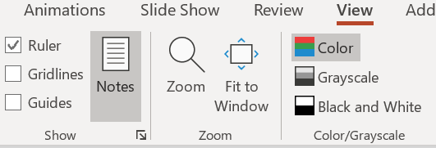
POWERPOINT FEATURES
There are three different slide ‘master’ layouts in this template.
  Right-click on the edge of the slide and select “Layout” to see the options.
Your speaking notes can be added to the slides: select the “View” menu
and enable the “Notes” button.

Slide 13
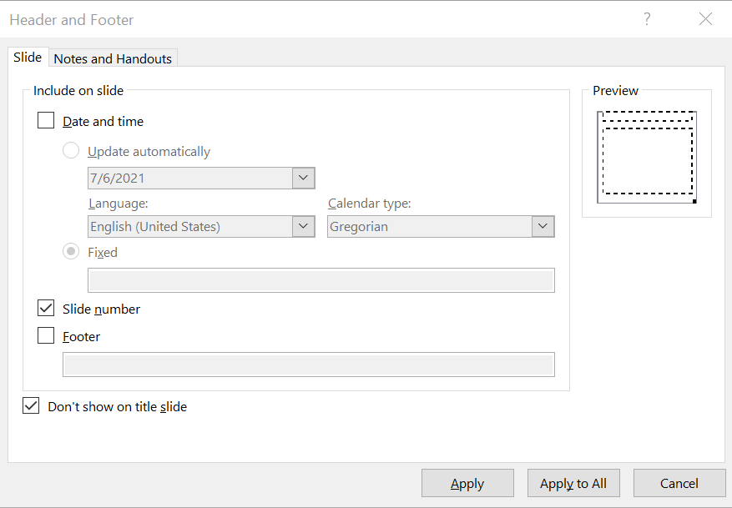
POWERPOINT FEATURES (CONTINUED)
Switch on slide numbering
using the “Insert” menu,
then “Header and Footer”
button

Slide 14
Rehearsing and Recording your Presentation
(only applicable for interactive presentations)

Slide 15
PREPARING YOUR VIDEO RECORDING
Preparing a recorded presentation is very similar to presenting online, with a few important differences. Most presentation software packages include a recording facility which allows you to attach audio clips to your presentation, and to export the complete presentation as a video file (MP4, WAV, etc).
Try to record your presentation in a single take, as if you were presenting live.
Video presentations can be more time-efficient than live talks: we advise you to use speaking notes so that your presentation is smooth and effective.
We would recommend using a headset to achieve the best audio quality.

Slide 16
PREPARING YOUR VIDEO RECORDING (CONTINUED)
We recommend webcam of yourself for the opening slide only, if you wish.
Your video presentation will be shown live and will also available for viewing after the Congress, so you please observe the following quality measures:
  Avoid slides which contain only text.
  When planning images, graphics and embedded videos, remember that your presentations may be viewed at low resolution (e.g. 640 x 480) so avoid very small symbols, fine lines, etc.

Slide 17
PREPARING YOUR VIDEO RECORDING (CONTINUED)
Playback your video presentation from start to finish before you upload.
  Your video will be reviewed by the local IT team before being uploaded to the Congress programme. You will be asked to re-record if quality is poor.
The expected file size for MP4 format is around 2.5 Mb per minute at a screen resolution of 1920 x 1080 pixels, 30 frames per second. If your file is significantly larger than this, you should adjust your recording settings.
  There is a file size limit of 300Mb in any case.

Slide 18
GUIDANCE FOR POWERPOINT USERS
Record a slide show with narration and slide timings (microsoft.com)
Go to “Slide Show” menu, select “Record Slide Show”
  Check the settings before you start
  A good idea is to show the notes, which can be zoomed in.
  At the bottom, there is an opportunity to switch video on or off.
Once you start, the recording will capture your voice and the timing of mouse clicks and therefore animations.
You can pause, resume, stop, replay, delete and re-record.

Slide 19
If you want to do a short presentation instead of a video it‘s also possible.
Please limit your presentation also to about 10 minutes to allow for questions.
The required file would be a Powerpoint .ppt file.
There will be the possibility to upload your presentation/video before the
congress. You‘ll recieve an email with the link when that starts.

